Slide 1
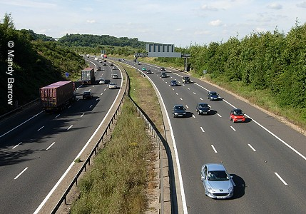
Transport in Britain
Roads and motorways are Britain's main transport routes. There are some 225,000 miles (362,000 km) of roads in Britain.

Slide 2
Motorcycles
Motorcycling is popular in Britain, both as a means of transport and as a pastime with over one million motorcyclists.
You can get a full motorcycle licence at the age of 17 after passing a test.

Slide 3
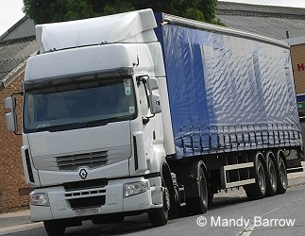
Lorries
At the beginning of the 20th century, railway trains and canal barges were the main means of transporting heavy goods. Now around 65% of them are carried by lorries.

Slide 4
Buses and Coaches
The British have single decker and double decker buses. You can see them in our towns and cities.
They use coaches for travelling longer distances or for going on school outings.

Slide 5
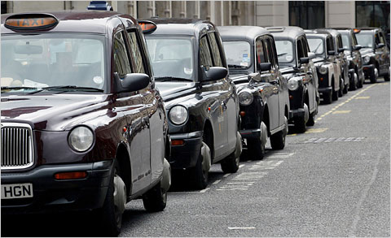
Taxis
In London, the taxis are black but in the rest of the country they are different colour.

Slide 6
Trains
The rail network in Britain is one of the most extensive in Europe with over 11,000 miles (17,500km) of lines.
There are some 2,500 stations and around 1,500 trains travel every day.

Slide 7
British cars
Are there any current British made cars?
This is an example of British brand - Aston Martin V8 Vantage.

Slide 8
British cars
British luxury car manufacturer
- Rolls-Royce
The Bentley was born in Britain. It’s very elegant.

Slide 9
British cars
The original Mini was introduced in 1959) – Millions of MINI have been sold worldwide since 2001, anymore to say?
Eternity Motors.

Slide 10
Made by: Jakub Szczurek

