Slide 1
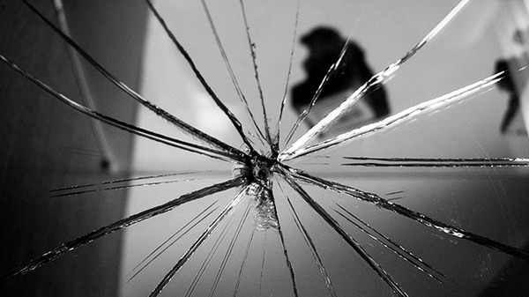
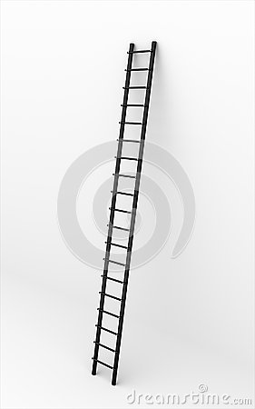
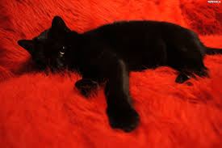
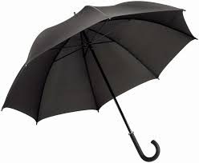
Superstitions in Great Britain

Slide 2
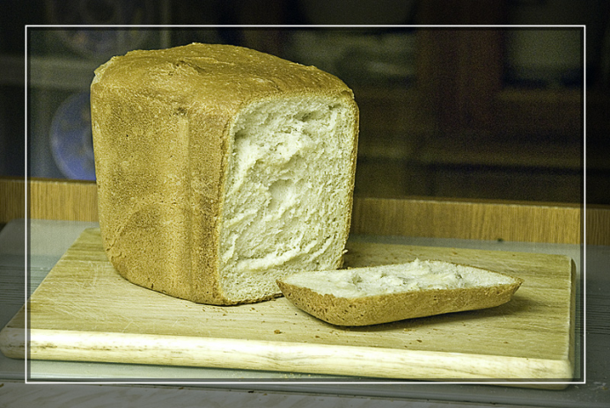
Food Superstitions
Boiled egg
Bread
When finished eating a boiled egg, push the spoon through the bottom of the empty shell to let the devil out.
In Yorkshire, housewives used to believe that bread would not rise if there was a corpse (dead body) in the vicinity, and to cut off both ends of the loaf would make the Devil fly over the house!

Slide 3
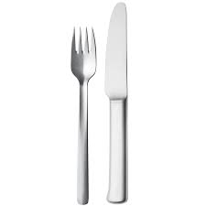
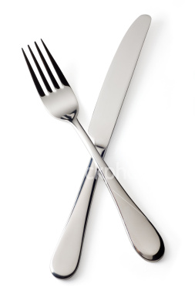
Table Superstitions
Knife and fork
Tablecloth, cutlery
If you drop a table knife expect a male visitor, if you drop a fork a female visitor.
Crossed cutlery on your plate and expect a quarrel.
Leave a white tablecloth on a table overnight and expect a death.

Slide 4
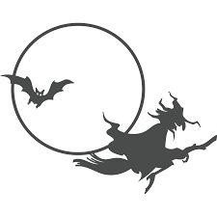
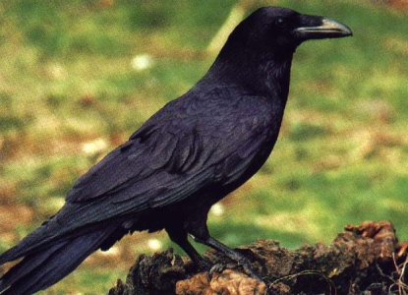
Animal Superstitions-1
Bears, bats
Raven
One ancient British superstition holds that if a child rides on a bear's back it will be protected from whooping-cough.
It is said to be bad luck if you see bats flying and hear their cries.
In some parts of the UK meeting two or three Ravens together is considered really bad. One very English superstition concerns the tame Ravens at the Tower of London. It is believed if they leave then the crown of England will be lost.

Slide 5
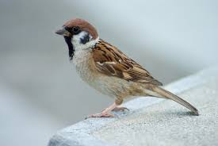
Animal Superstitions-2
Sparrow
Black Rabbit and White Rabbit
If a Sparrow enters a house it is an omen of death to one of the people who live there. In some areas it is believed that to avoid bad luck, any Sparrow caught must be immediately killed otherwise the person who caught it will die.
In some areas black Rabbits are thought to host the souls of human beings. White Rabbits are said to be really witches and some believe that saying 'White Rabbit' on the first day of each month brings luck. A common lucky charm is a Rabbit's foot, but not for the Rabbit.

Slide 6
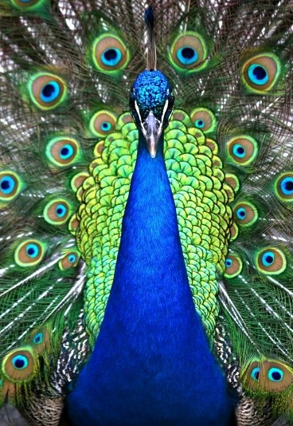
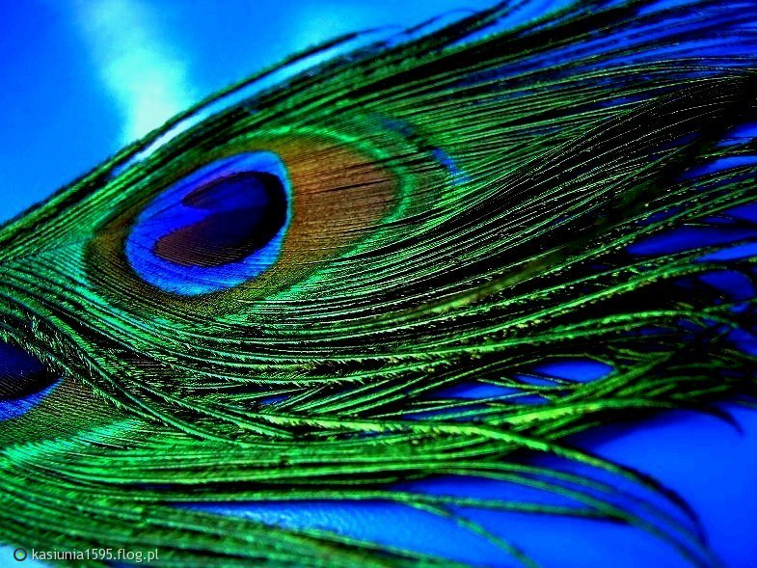
Animal Superstitions-3
Peacock
It is thought very unlucky to have the feathers of a Peacock within the home or handle anything made with them. This is possibly because of the eye shape present upon these feathers i.e. the Evil-Eye associated with wickedness.

Slide 7
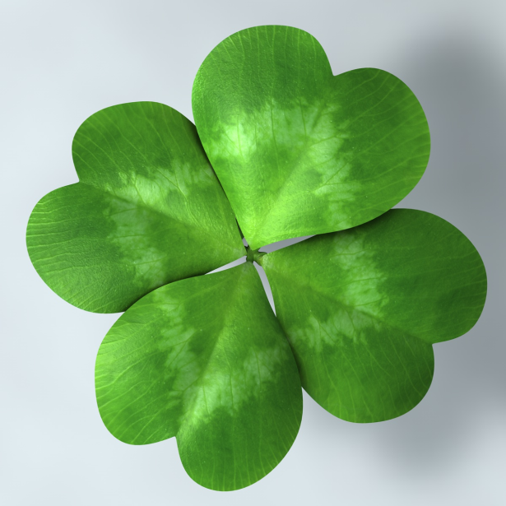
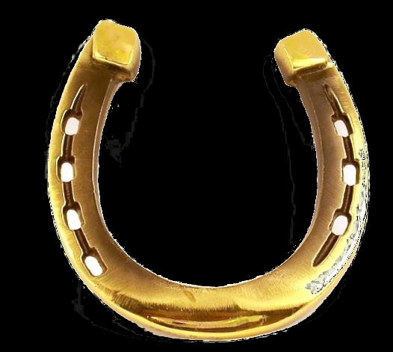
Good luck
Black cat, touch wood, clover
White heather , horseshoe
Lucky to meet a black cat.
Lucky to touch wood.
Lucky to find a clover plant with four leaves.
White heather is lucky.
A horseshoe over the door brings good luck. But the horseshoe needs to be the right way up. The luck runs out of the horseshoe if it is upside down.

Slide 8
Good luck
Horseshoes , white rabbits
Leaves, moon and hair pocket
Horseshoes are generally a sign of good luck and feature on many good luck cards.
On the first day of the month it is lucky to say "white rabbits, white rabbits white rabbits," before uttering your first word of the day.
Catch falling leaves in Autumn and you will have good luck. Every leaf means a lucky month next year.
Cut your hair when the moon is waxing and you will have good luck.
Putting money in the pocket of new clothes brings good luck.

Slide 9
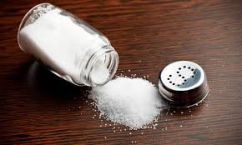
Bad luck
Ladder, mirrors
Magpie, salt, umbrella
Unlucky to walk underneath a ladder.
Seven years bad luck to break a mirror. The superstition is supposed to have originated in ancient times, when mirrors were considered to be tools of the gods.
Unlucky to see one magpie, lucky to see two, etc..
Unlucky to spill salt. If you do, you must throw it over your shoulder to counteract the bad luck.
Unlucky to open an umbrella in doors.

Slide 10
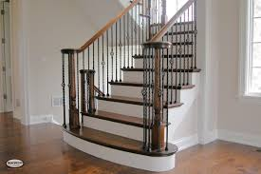
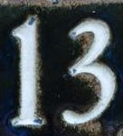
Bad luck
Thirteen
Shoes, stairs
The number thirteen is unlucky. Friday the thirteenth is a very unlucky day. Friday is considered to be an unlucky day because Jesus was crucified on a Friday.
Unlucky to put new shoes on the table.
Unlucky to pass someone on the stairs.

Slide 11
Thank you!
Made by : Oliwia Bulanda

