Slide 1
Special Days and Festivals

Slide 2
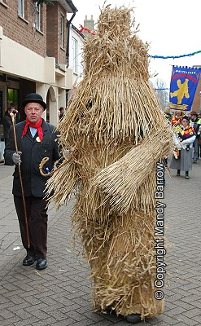
Whittlesey Straw Bear Festival in January
In January the Day of Straw Bear
is celebrated. Men and boys dress up as
Straw bears. Bears circulate on the streets,
dancing and parading.

Slide 3
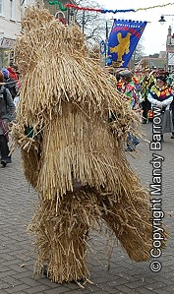

Slide 4
Valentine's Day in February
In February the Valentine’ s Day is celebrated. On this day
women and men punch in the paper heart and write
"Valentine" and give them to people who they like or love.

Slide 6
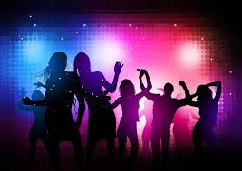
St. Andrew's Day, in November
In November St. Andrew’s Day is celebrated. On this day
people dance at the party!

Slide 8
Halloween in October
In Halloween children go from one house to another and say:
,,Trick or Treat’’ wearing monster, zoombie, skeletons
and many many other clothes!

Slide 9
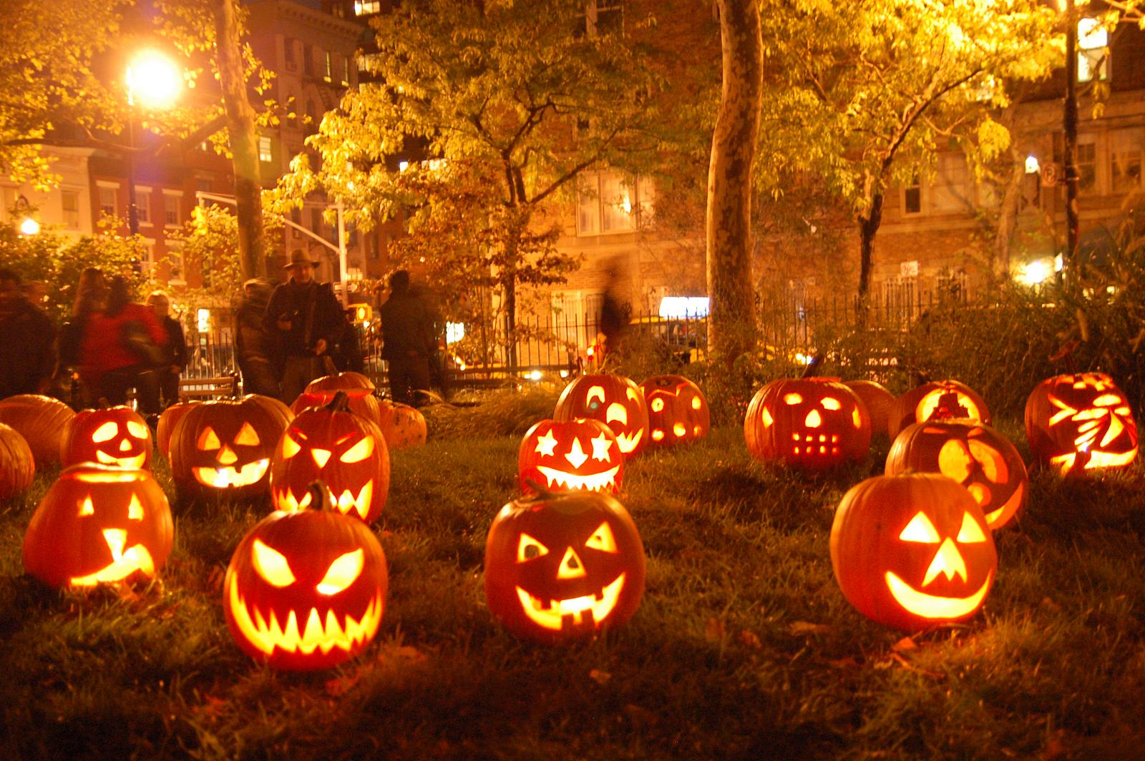

Slide 11
Thank You!
Made by: Magdalena Biskup

