Slide 1
Great Britain Factfile
TEN FACTS ABOUT GREAT BRITAIN

Slide 2
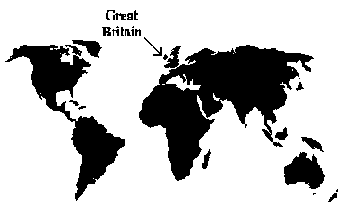
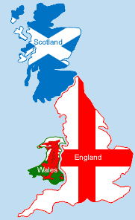
1. Great Britain is an island lying on the west of Europe.
2. Great Britain is made up of England, Scotland and Wales.
3. Great Britain has an area of 229,850km².

Slide 3
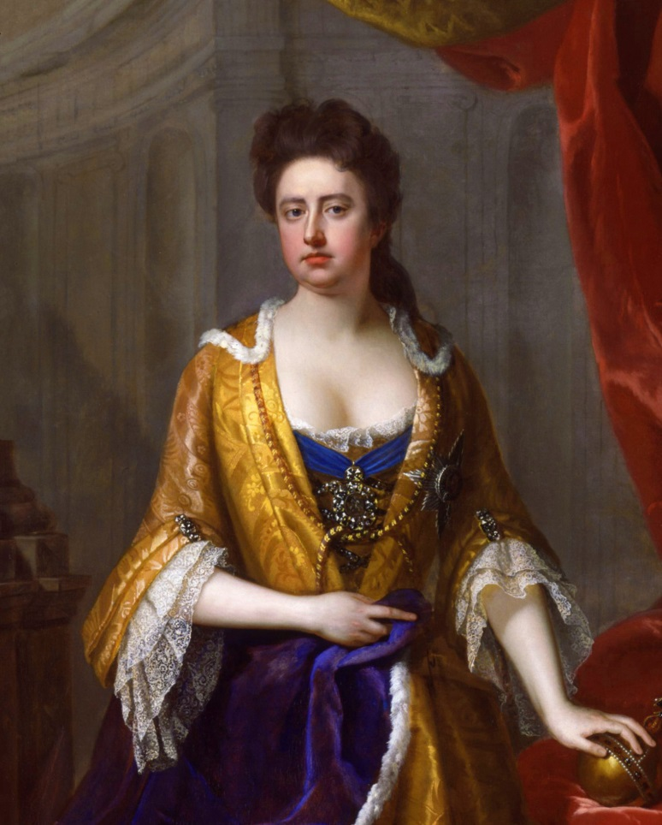
4. The first monarch of Great Britain
was Anne Stuart.

Slide 4
5. In Great Britain 98% of the people speak English, 1% speak Welsh.
6. 64,1 mln people live in Great Britain.
7. Most immigrants in Great Britain are from Poland.
8. Great Britain is the largest island of the British Isles.

Slide 5
9.The ethnic groups in Great Britain are 86.8% White, 7.1% Asian, 3.1% Black, 2.0 mixed, 0.3% Arab, 0.6% other.

Slide 6
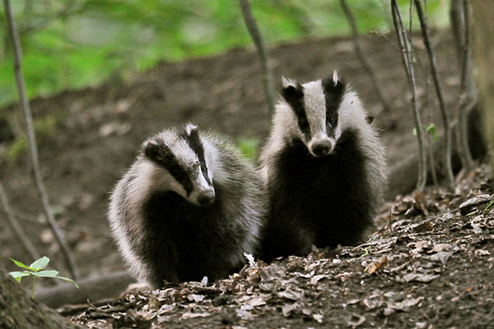
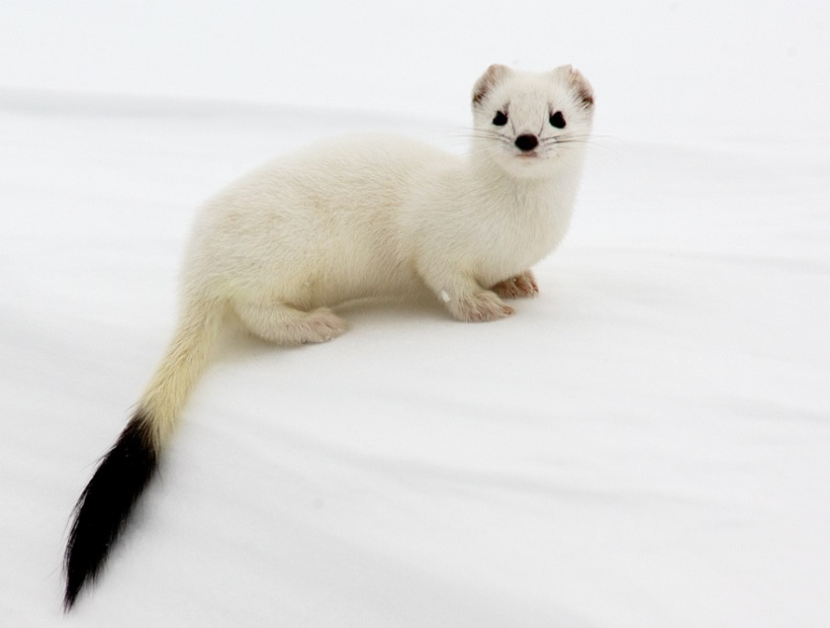
10. In Great Britain there are many deer, foxes, badgers, otters, stoats, and species of birds and fish.

Slide 7
MADE BY:
Helenka Nagy

