Slide 1
The British Government

Slide 2
Who runs the UK?
The British government runs the UK. The leader of the government is the Prime Minister.

Slide 3
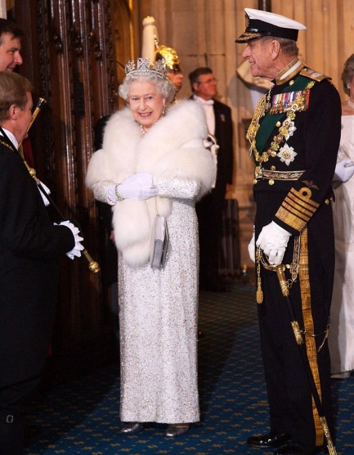
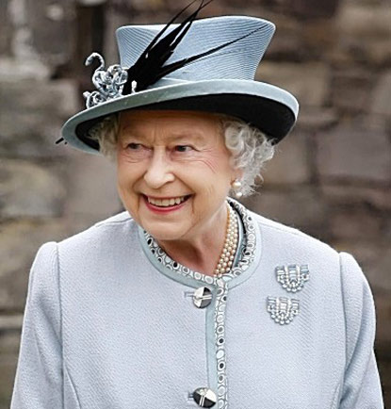
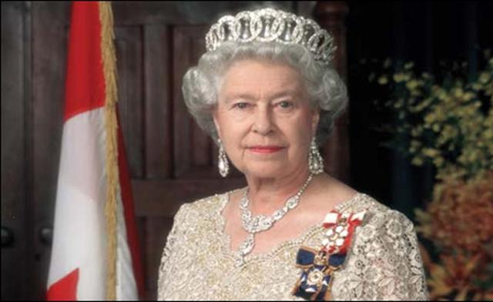
Parliamentary democracy
Great Britain (UK) is a parliamentary democracy with a constitutional Monarch as Head of State.

Slide 4
The British Government
The two Houses of the Parliament of the United Kingdom (the House of Lords and the House of Commons) are based at The Palace of Westminster, also known as the Houses of Parliament, in London.

Slide 5
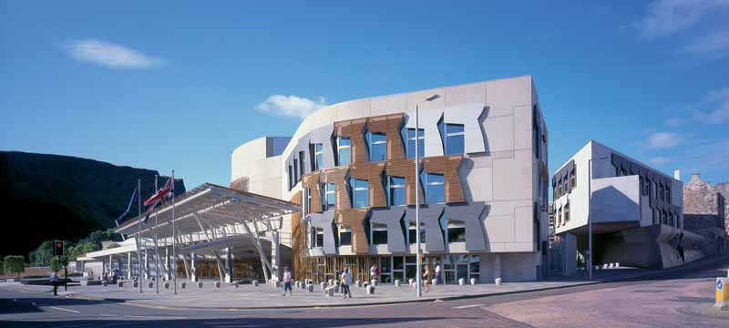
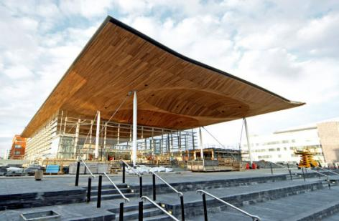
Scottish Parliament
National Assembly for Wales.
Scotland and Wales have their separate parliaments.
National Assembly for Wales.
Scottish Parliament .

Slide 6
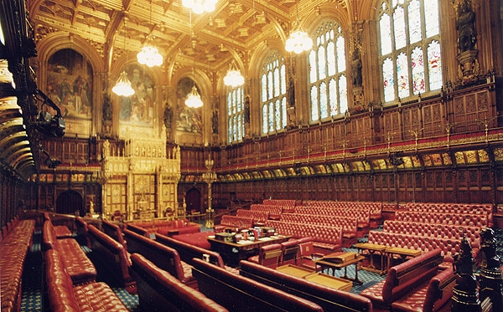
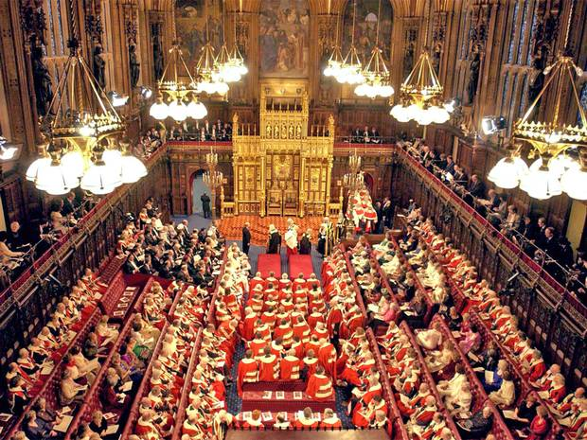
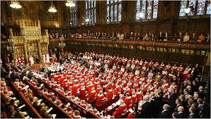
British Parliament consists of the House of Commons and the House of Lords .

Slide 7
The Palace of Westminster (Houses of Parliament) where the UK Government sits

Slide 8
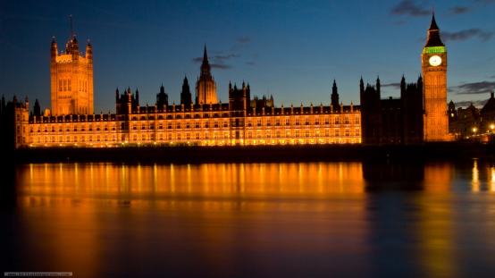
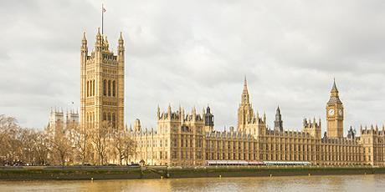
Parliament decides the laws and make decisions on running the UK. (Some issues in Scotland, Wales and Northern Ireland are now dealt with by their respective parliaments and assemblies.) There has been a parliament at Westminster since the 13th Century.

Slide 10
MADE:
Dajana Majda

